Slide 1
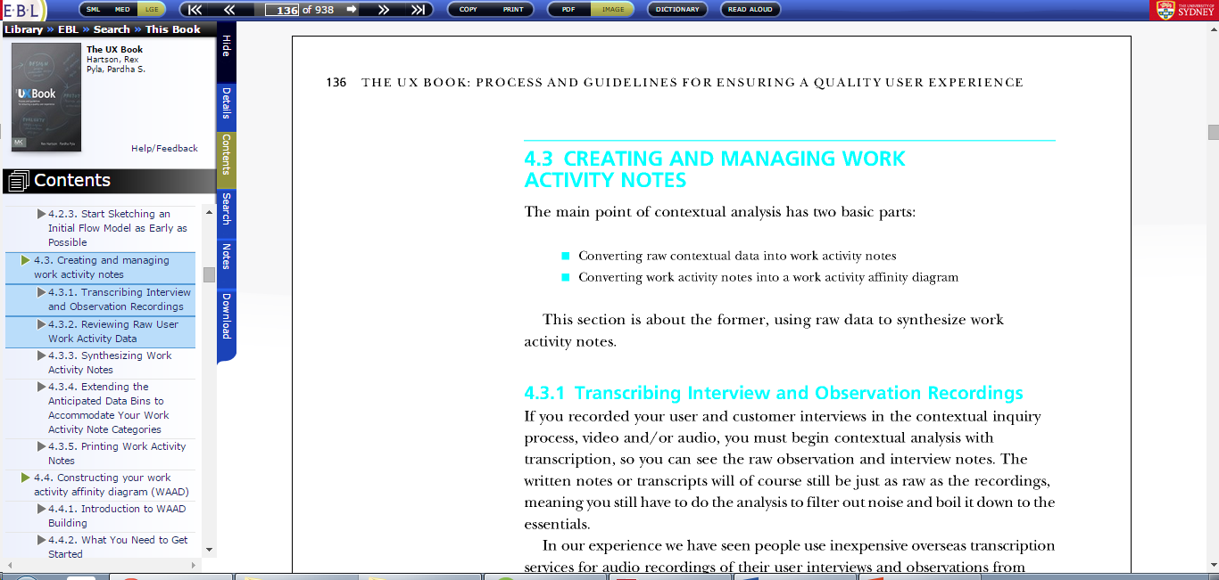
Task 1.3 : Navigate to section 3 of chapter 4 (CREATING AND MANAGING WORK ACTIVITY NOTES)

Slide 2
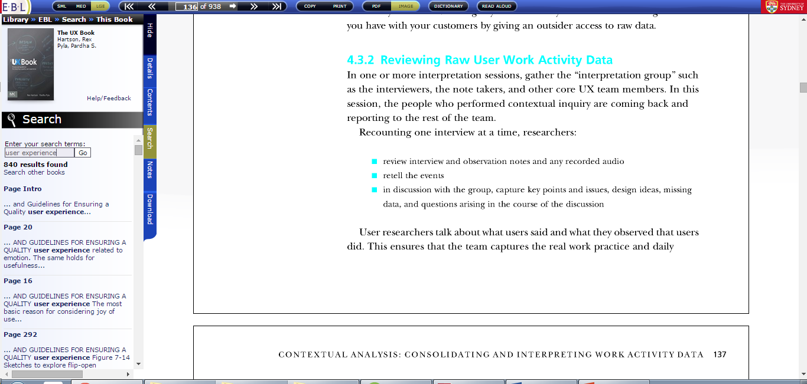
Task 2.1 : Search for some specific contents

Slide 3
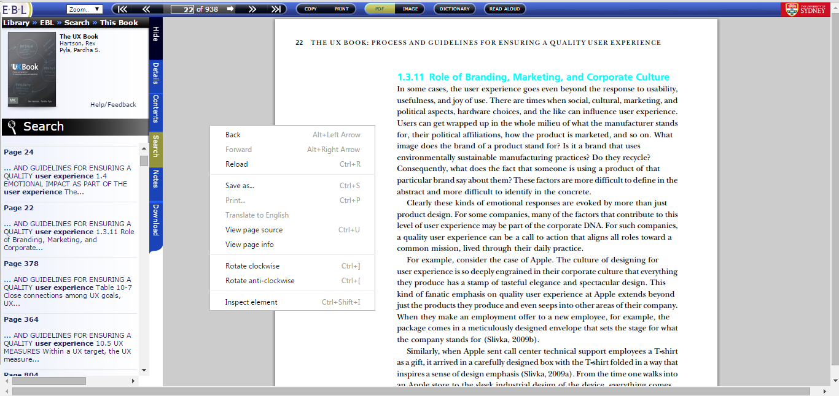
Task 2.2 : Search the word “user experience”

Slide 4
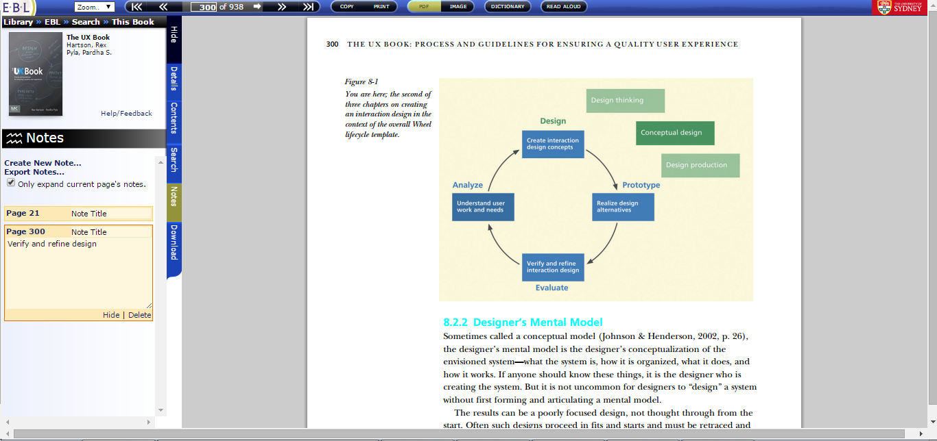
Task 3.2 : Make the note "Verify and refine design" on page 300

Slide 5
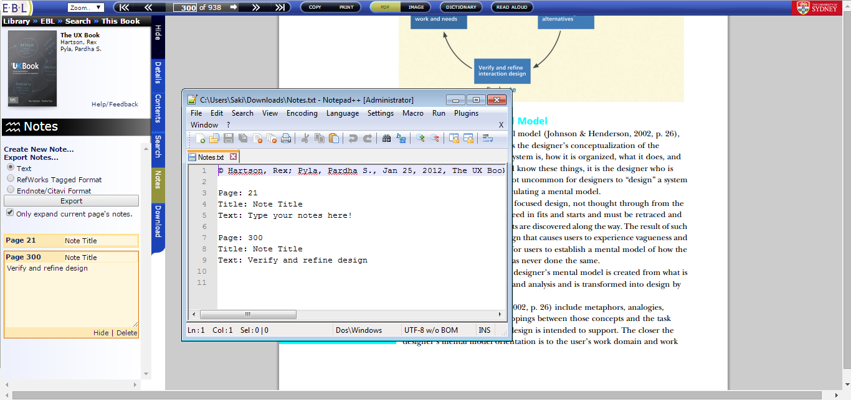
Task 3.3 : Export the notes you have made as a text file

Slide 6
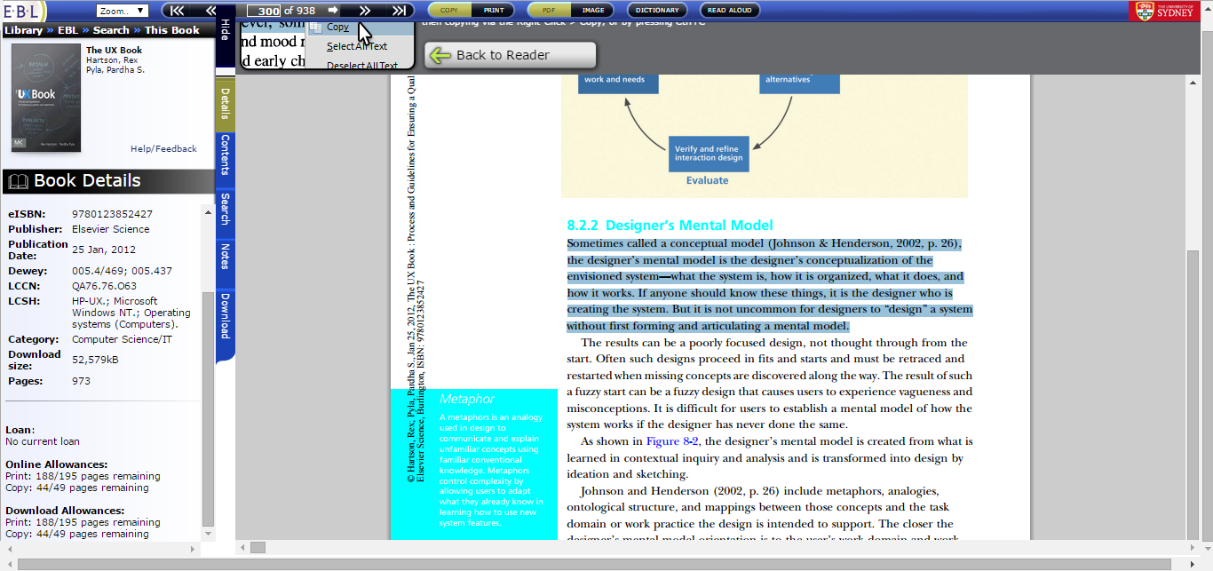
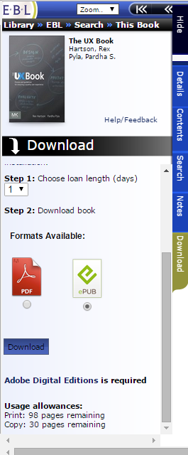
Task 4.1 : Copy a paragraph to the clipboard

Slide 7
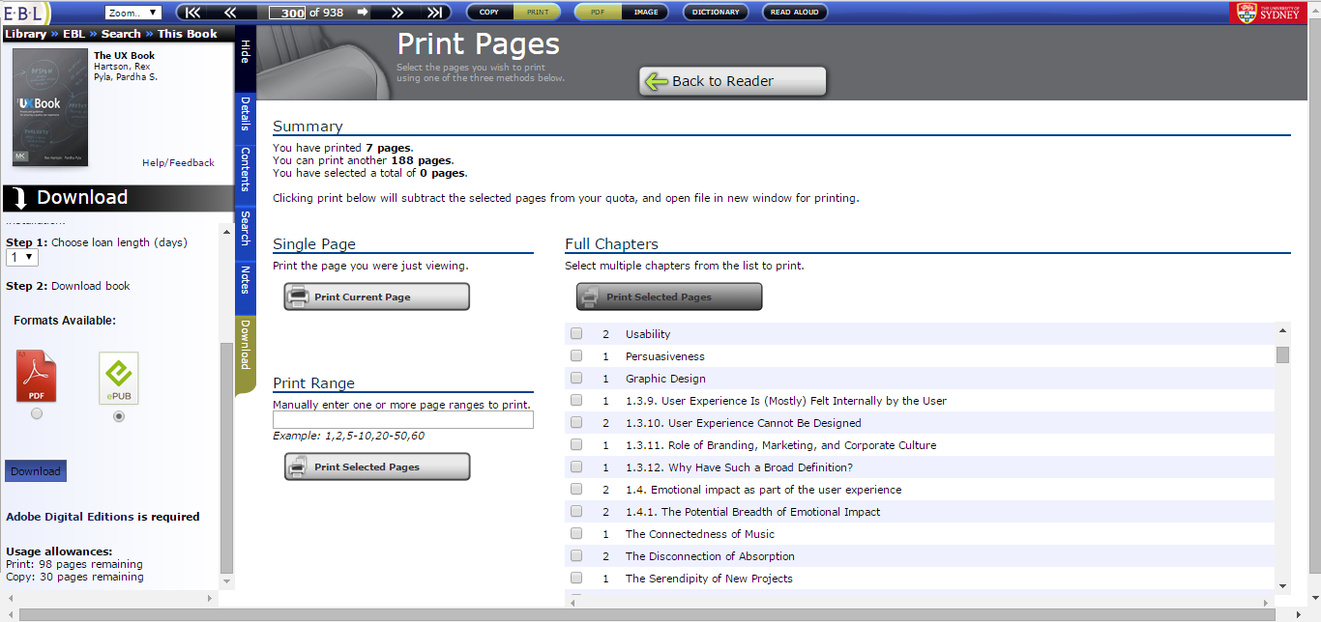
Task 4.2 : Print the “Preface” of the book

Slide 8
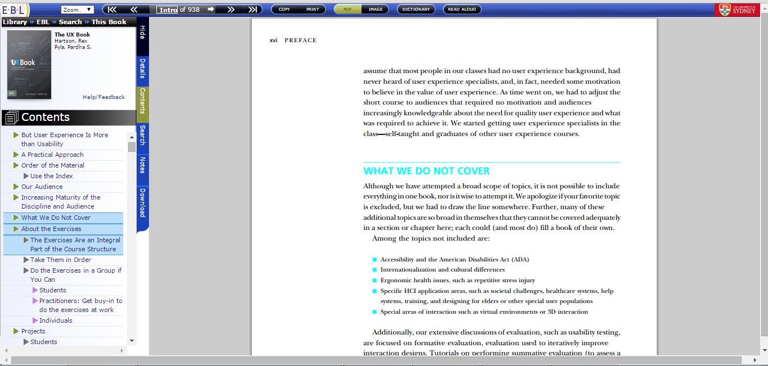
Task 5.1 : Use additional tools

Slide 9
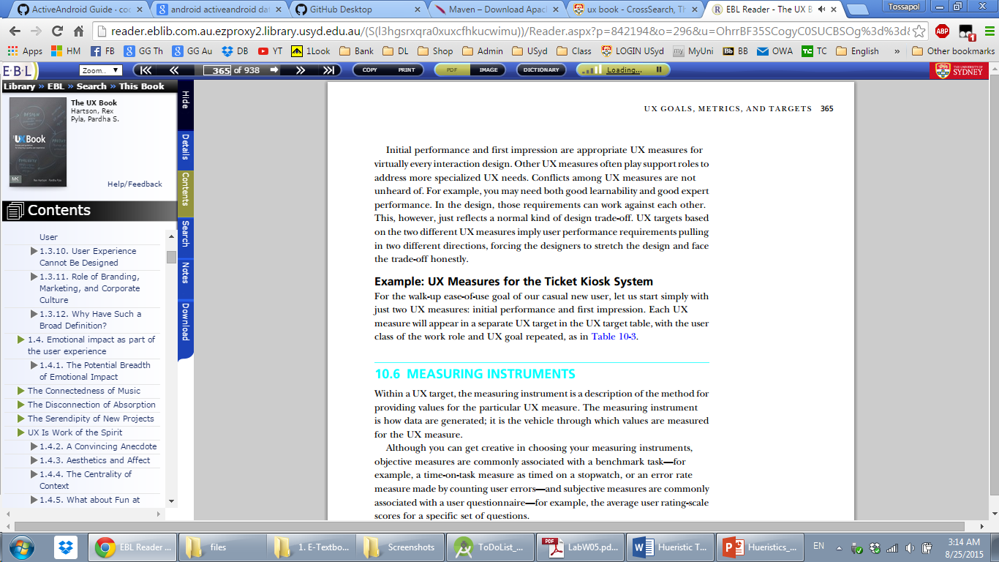
Task 5.2 : In pdf mode, have the system to read-aloud the page 365

